Slide 1
Automatic Generation of 3D Environment Models from Robot Sensor Data
Tom-Ole Korbach
Anton Wagner

Slide 2
1
Introduction
2
Current Approach
3
Current Progress
4
Timeline

Slide 3
Introduction
1

Slide 4
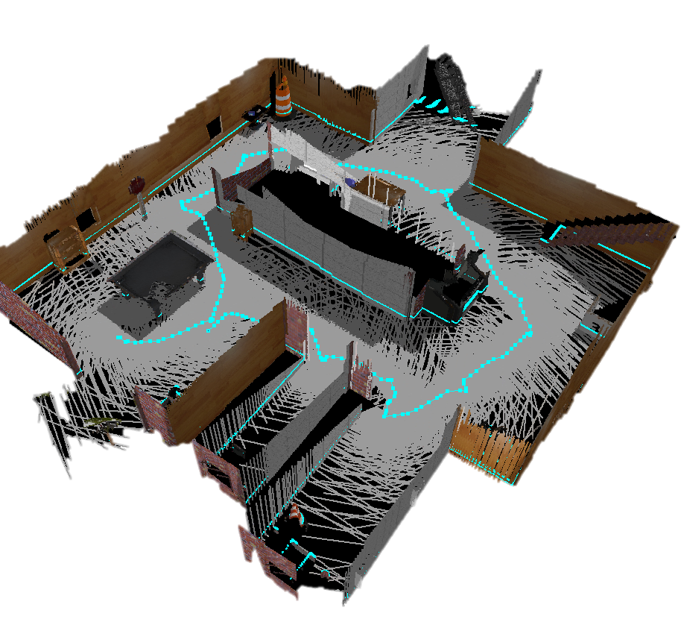
Introduction
Automatic Generation of 3D Environment Models from Robot Sensor Data
Useful for:
Robotics
Mapping
Digital Twins
Possible Sensors:
Cameras
Color
Depth
LiDAR
…
Raw sensor data != usable 3D model
Existing pipelines are:
Complex
Not fully automated
https://capsulesbot.com/blog/2018/06/11/robotics-projects.html

Slide 5
Current Approach
2

Slide 6
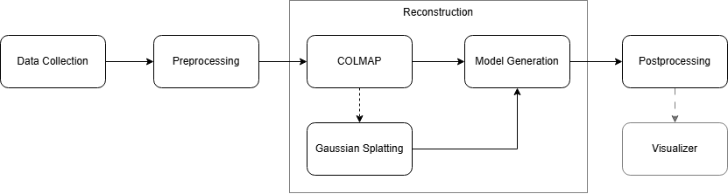
Current Approach

Slide 7
Current Progress
3

Slide 8
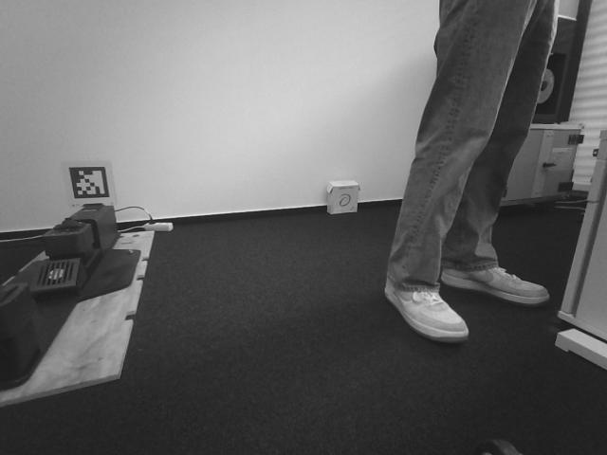

Current Progress
Researched Algorithms and Techniques
Understanding the Spot SDK
Started Data pipeline
Getting Camera/Image data
Recording Paths
Running Paths
For Presentation purpose:
Brightness: +40% Contrast: -40%

Slide 9
Timeline
4

Slide 10
Timeline

Slide 11
Questions?
5

